Slide 1
Integración Numérica
Dr. Luis Sanchez

Slide 2
What is Integration?
Integrate means “to bring together”, as parts, into a whole; to indicate total amount.
The above stands for integral of function f(x) with respect to the independent variable x between the limits x = a to x = b.

Slide 3
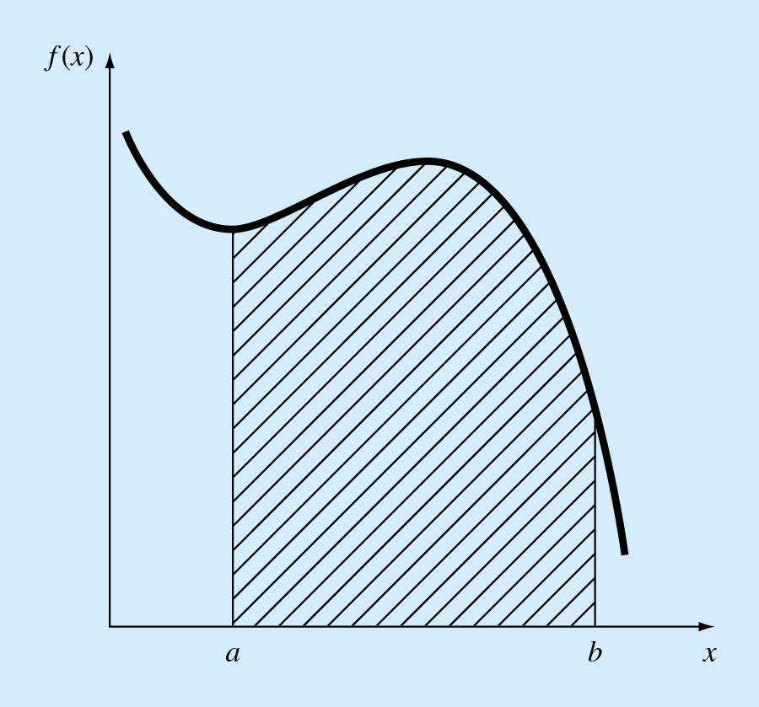
What is Integration?
Graphically integration is simply to find the area under a certain curve between the 2 integration limits.

Slide 4
Newton-Cotes integration Formulas Introduction
The Newton-Cotes formulas are the most common numerical integration methods.
They are based on the strategy of replacing a complicated function with an approximating function that is easy to integrate.

Slide 5
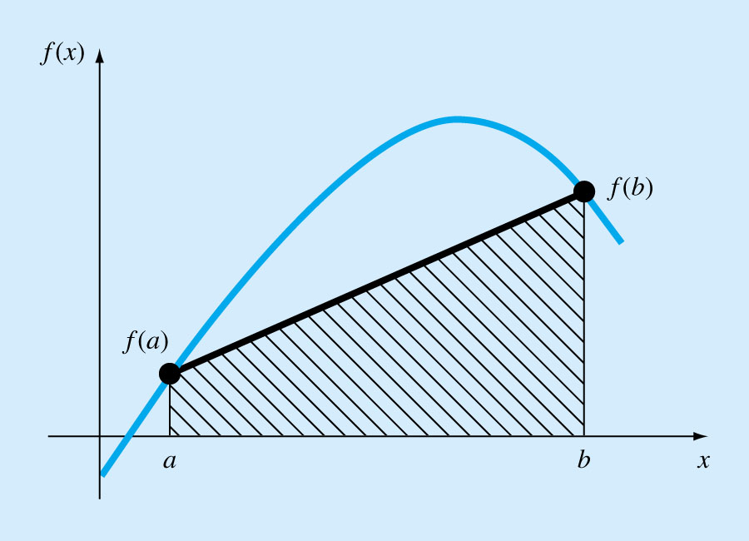
1. Trapezoidal Rule
The trapezoidal rule uses a polynomial of the first degree to replace the function to be integrated.

Slide 6
Trapezoid Method Derivation-One Interval

Slide 7
Trapezoid Method
f(x)

Slide 8
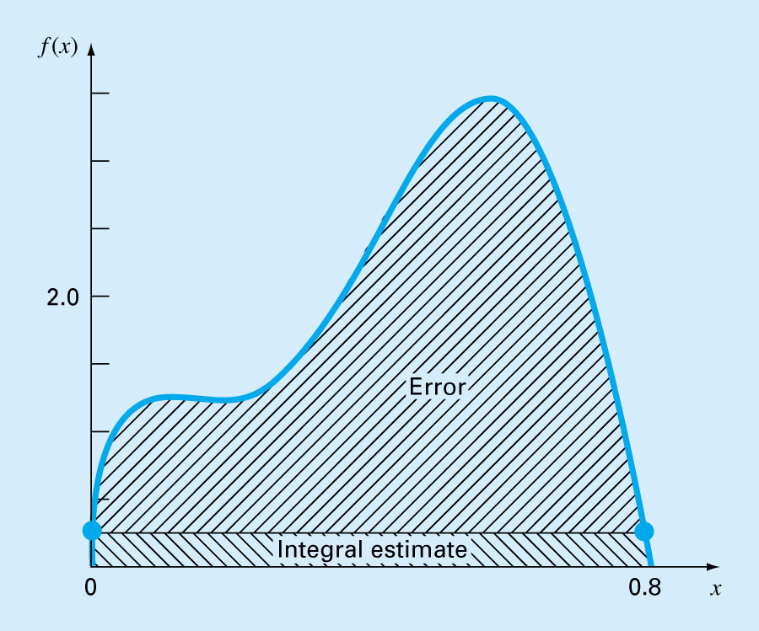
Error of the Trapezoidal Rule
When we employ the integral under a straight-line segment to approximate the integral under a curve, error may be:
Where ξ lies somewhere in the interval from a to b.

Slide 9
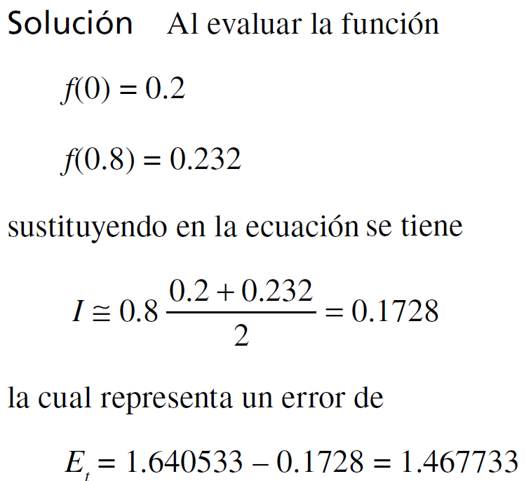
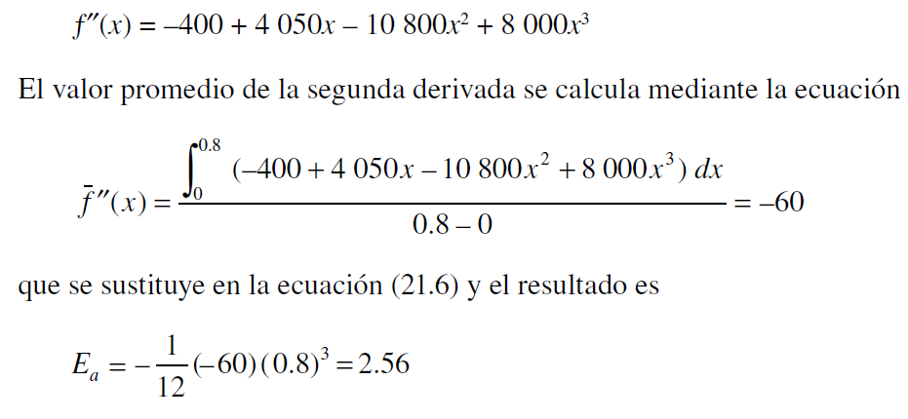
Ejemplo: Aplicación simple de la regla del trapecio
Integre numéricamente de f(x) desde a = 0 hasta b = 0.8. El valor exacto de la integral se puede determinar en forma analítica y es 1.640533.
En situaciones reales, no conocemos valor verdadero. Por lo tanto, se requiere una estimación del error aproximado. Para obtener dicha estimación usamos la expresión anterior para el error y aproximamos ƒ’’(ξ ) como el promedio de la segunda derivada en dicho intervalo.
Que corresponde a un error relativo porcentual de e_{t} = 89.5%.

Slide 10
Multiple Trapezoidal Rule
One way to improve the accuracy of the trapezoidal rule is to divide the integration interval from a to b into a number of segments and apply the method to each segment.
The areas of individual segments can then be added to yield the integral for the entire interval.

Slide 11
Trapezoid Method Multiple Application Rule
f(x)
x
a
b

Slide 12
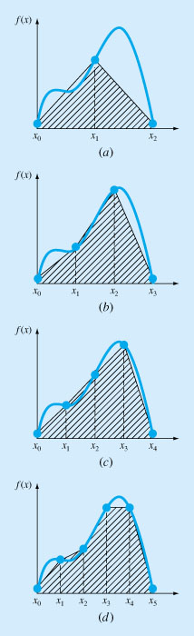
Multiple Trapezoidal Rule

Slide 13
Multiple Trapezoidal Rule
Substitute into the integrals for f(x) by f₁(x) in each segment and integrate:

Slide 14
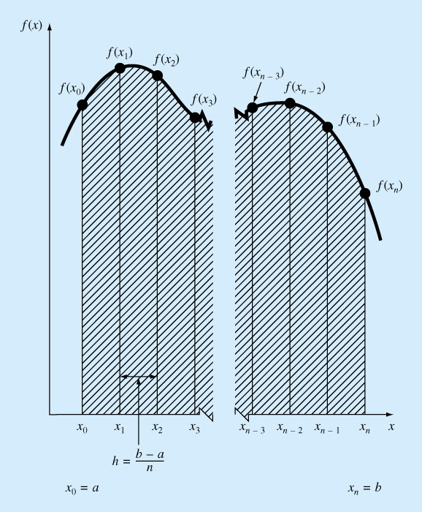

Slide 15
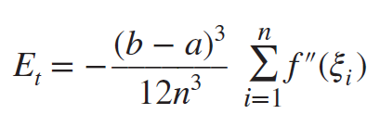
Multiple Trapezoidal Rule
An error for multiple-application trapezoidal rule can be obtained by summing the individual errors for each segment:

Slide 16
Example
Given a tabulated values of the velocity of an object.
Obtain an estimate of the distance traveled in the interval [0,3].
Time (s) | 0.0 | 1.0 | 2.0 | 3.0
Velocity (m/s) | 0.0 | 10 | 12 | 14
Distance = integral of the velocity

Slide 17
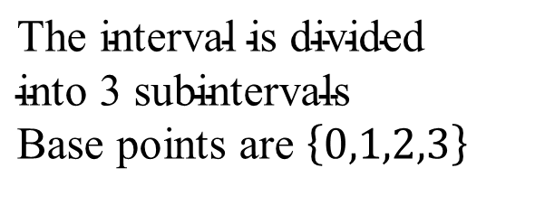
Example 1
$$\text{The} \text{interval} \text{is} \text{divided} \\ \text{into} \text{3} \text{subintervals} \\ \text{Base} \text{points} \text{are} \left\{0,1,2,3\right\}$$
Time (s) | 0.0 | 1.0 | 2.0 | 3.0
Velocity (m/s) | 0.0 | 10 | 12 | 14

Slide 18
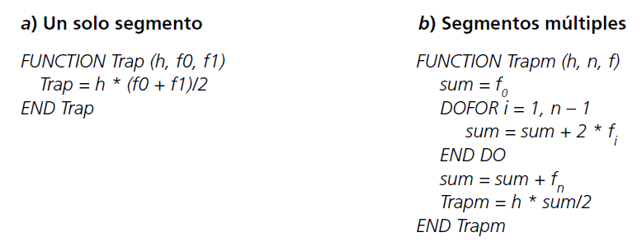
Algoritmos computacionales para la regla del trapecio

Slide 19
Matlab Codigo: Multiples segmentos
function I = trap(func,a,b,n,varargin)
if nargin<3
error('at least 3 input arguments required');
end
if ~(b>a)
error('upper bound must be greater than lower');
end
if nargin<4||isempty(n)
n = 100;
end
x = a; h = (b-a)/n;
s=func(a,varargin{:});
for i=1:n-1
x = x + h;
s = s + 2*func(x,varargin{:});
end
s = s + func(b,varargin{:});
I = (b-a)*s/(2*n);
end

Slide 20
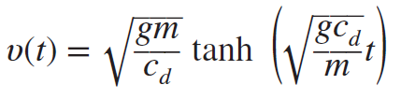
Ejemplo
Determine the distance fallen by the free-falling bungee jumper in the first 3 s by evaluating the integral of Eq. (1). For this example, assume the following parameter values: g = 9.81 m/s2, m = 68.1 kg, and cd = 0.25 kg/m. Note that the exact value of the integral can be computed as 41.94805.
…..(1)
>> v=@(t) sqrt(9.81*68.1/0.25)*tanh(sqrt(9.81*0.25/68.1)*t)
>> format long
>> trap(v,0,3,5)

Slide 21
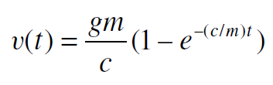
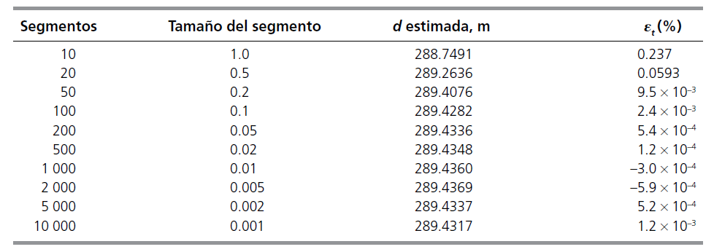
Ejemplo
Determine the distance fallen by the free-falling bungee jumper in the first 10 s by evaluating the integral of Eq. (1). For this example, assume the following parameter values: g = 9.81 m/s2, m = 68.1 kg, and cd = 12.5 kg/m. Note that the exact value of the integral can be computed as 289.43515.
…..(1)

Slide 22
Simpson’s Rules
More accurate estimate of an integral is obtained if a high-order polynomial is used to connect the points. The formulas that result from taking the integrals under such polynomials are called Simpson’s Rules.

Slide 23
Simpson’s Rules
Simpson’s 1/3 Rule
Results when a second-order interpolating polynomial is used.
Simpson’s 3/8 Rule
Results when a third-order (cubic) interpolating polynomial is used.

Slide 24
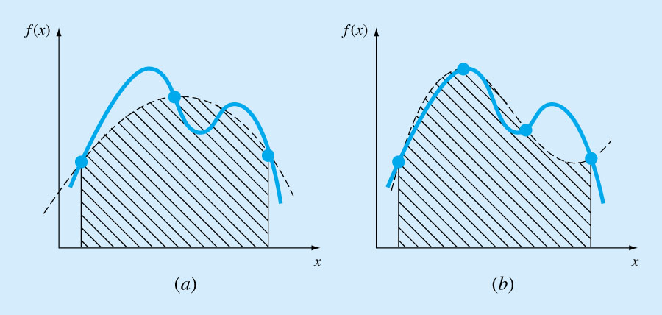
Simpson’s Rules
Simpson’s 1/3 Rule Simpson’s 3/8 Rule

Slide 25
Simpson’s 1/3 Rule
Simpson’s 1/3 Rule

Slide 26
Simpson’s 1/3 Rule
Single segment application of Simpson’s 1/3 rule has a truncation error of:
Simpson’s 1/3 rule is more accurate than trapezoidal rule.

Slide 27
The Multiple-Application Simpson’s 1/3 Rule
Just as the trapezoidal rule, Simpson’s rule can be improved by dividing the integration interval into a number of segments of equal width.

Slide 28
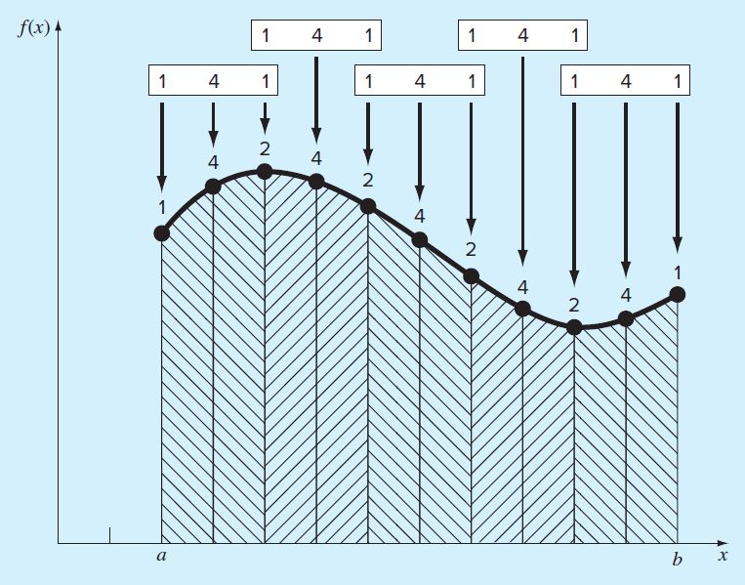
The Multiple-Application Simpson’s 1/3 Rule

Slide 29
Simpson’s 3/8 Rule
If there are 2 extra points between the integration limits a and b, then a 3rd degree polynomial can be used instead of the parabola to replace the function to be integrated:
Simpson’s 3/8 Rule

Slide 30
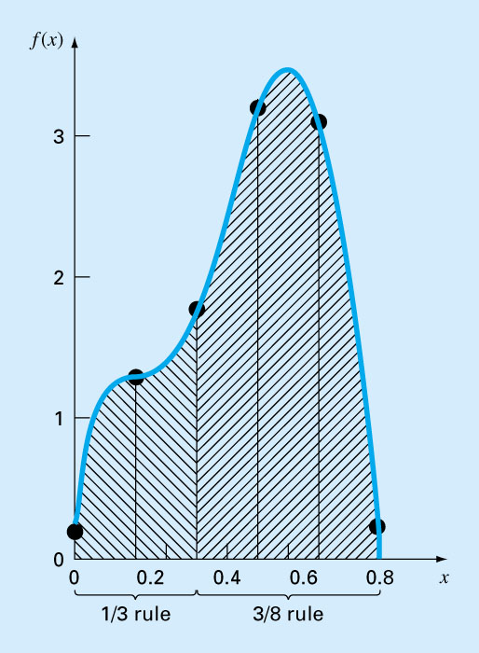
Illustration of how Simpson’s 1∕3 and 3∕8 rules can be applied in tandem to handle multiple applications with odd numbers of intervals.

Slide 31
Newton Cotes Integration-Example
Find the integral of:
f(x) = 0.2 +25 x – 200 x ² + 675 x ³ – 900 x ⁴ + 400 x ⁵
Between the limits 0 to 0.8, f(0) = 0.2, f(0.8) = 0.232,
I_{exact}=1.640533
The trapezoidal rule (ans. 0.1728)

Slide 32
Newton Cotes Integration-Example
Multiple trapezoidal rule (n=4) (ans. 1.4848)
f(0)=0.2, f(0.2)=1.288, f(0.4)=2.456, f(0.6)=3.464 ,f(0.8)=0.232

Slide 33
Newton Cotes Integration-Example
The Simpson 1/3 rule (ans. 1.367467)
f(0) = 0.2, f(0.4) = 0.2.456, f(0.8) = 0.232

Slide 34
Newton Cotes Integration-Example
Multiple application of Simpson 1/3 rule (n=4)
(ans. 1.623467).
f(0)=0.2, f(0.2)=1.288, f(0.4)=2.456, f(0.6)=3.464 ,f(0.8)=0.232

Slide 35
Newton Cotes Integration-Example
The Simpson 3/8 rule (ans. 1.519170)
f(0)=0.2, f(0.2667)=1.432724, f(0.5333)=3.487177, f(0.8)=0.232

Slide 36
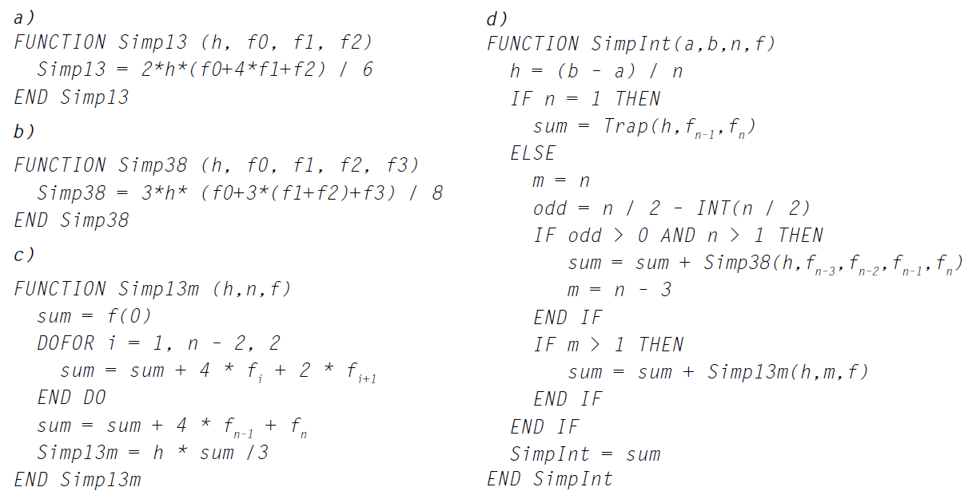
Pseudocódigo para las reglas de Simpson. a) Regla de Simpson 1/3 para una sola aplicación, b) regla de Simpson 3/8 para una sola aplicación, c) regla de Simpson 1/3 de aplicación múltiple y d) regla de Simpson de aplicación múltiple para un número de segmentos tanto impares como pares. Observe que para todos los casos n debe ser >= 1.

Slide 37
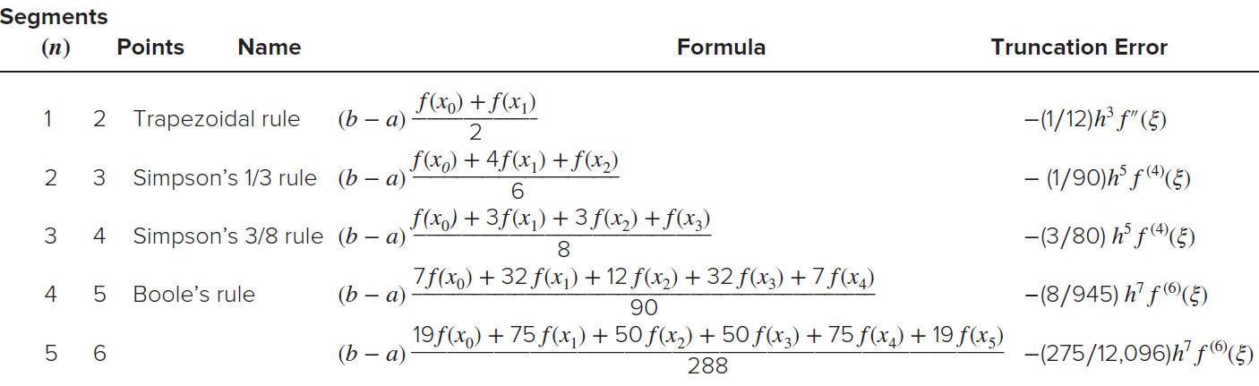
HIGHER-ORDER NEWTON-COTES FORMULAS
Newton-Cotes closed integration formulas. The formulas are presented in the form so that the weighting of the data points to estimate the average height is apparent. The step size is
given by h = (b − a)/n.

